Slide 1
Parents meeting
Kilvrough!

Slide 2

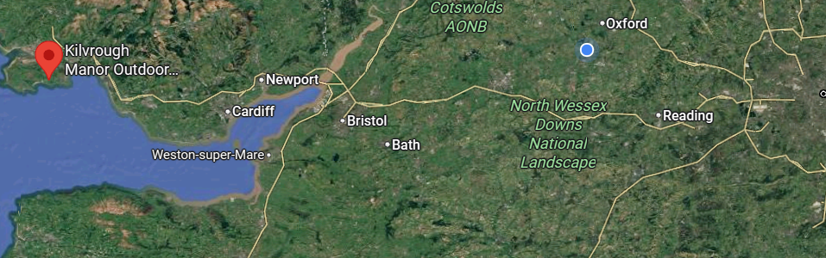
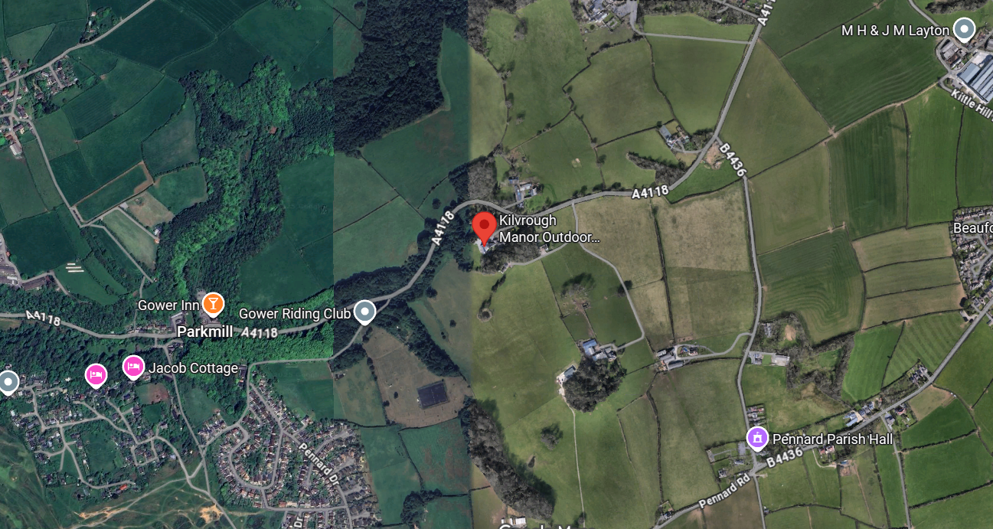
Where is Kilvrough?

Slide 3
Travelling
Travelling by coach on Monday morning – 7:45 am
Home on Friday evening

Slide 4
Staff
Miss Knowles – any questions, please contact me (trip lead)
Mr Clayton
Miss Priddle

Slide 5
Timings
Arrive at school on Monday morning at 7:30am
We will leave on the bus at 7:45am.
We pick up another school from Freeland (Witney)
We then leave Kilvrough at 3pm on Friday (just in time for rush hour!)

Slide 6
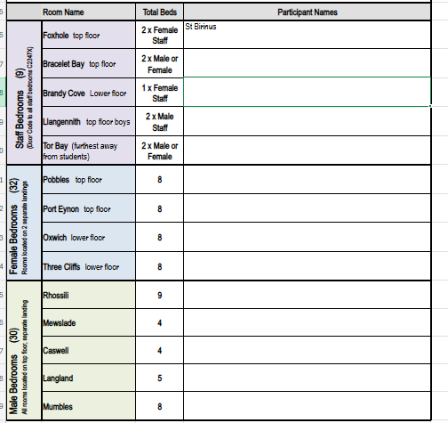
Rooms
We are hopeful to get these rooms – I am discussing with Freeland.

Slide 7
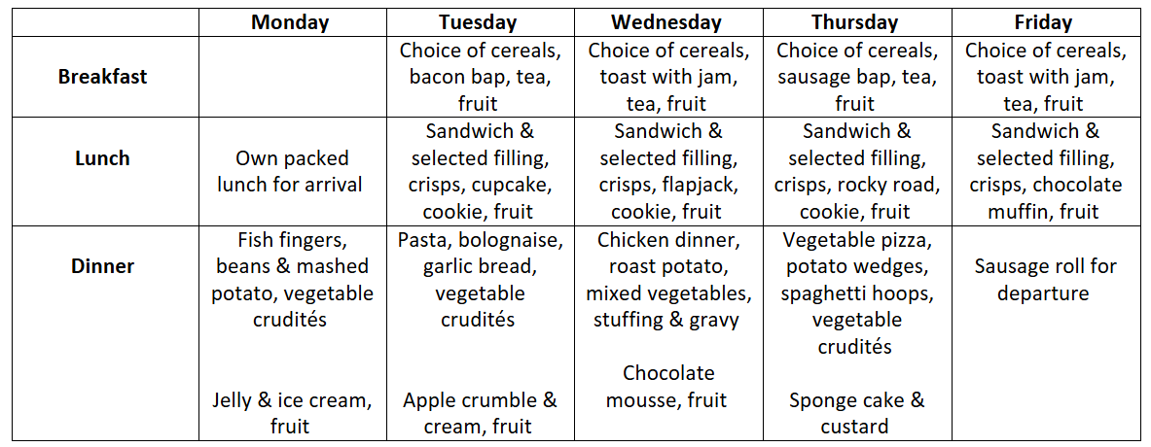
Sample menu - Food
Provided on site.
Previously enjoyed by the majority.
Allergies, vegetarian etc very clearly labelled.

Slide 8
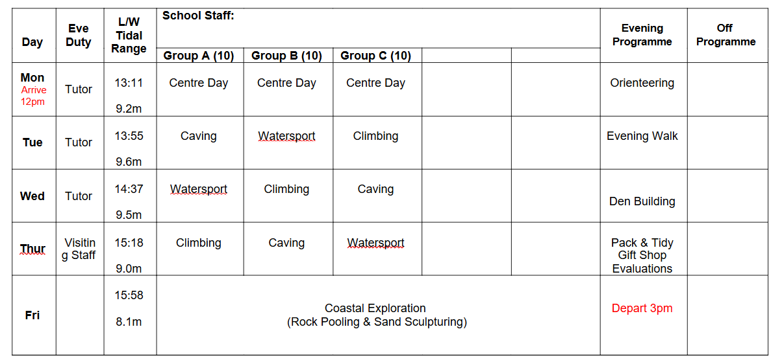
Timetable of activities - example

Slide 9
Communication
We will contact the school regularly who will share updates via ParentMail.
We will share pictures after the event.
In the case of an emergency or accident we will contact you.
If there is an emergency and you need to contact us, please go through the school office as normal.
OR I will still be getting emails – if there is something which you think we need to know – phone the office first and then email.
(i.knowles@marcham.oxon.sch.uk)
The number for contacting us in an emergency, the same as last time (07378604341)

Slide 10
Medication
Forms will go out asking for their emergency contact details and confirmation of any special dietary requirements/allergens and regular medication that may need taking.
Any prescribed medication that is stored in school will be taken with us - (eg epi pen/inhalers).
Any other prescribed medication that that the children take regularly at home, that is not stored in school will need to be handed in on the morning and a form from the school office completed.
As staff, we will have emergency Calpol/Paracetamol with us - we will ring you for permission if we feel a child needs some.

Slide 11
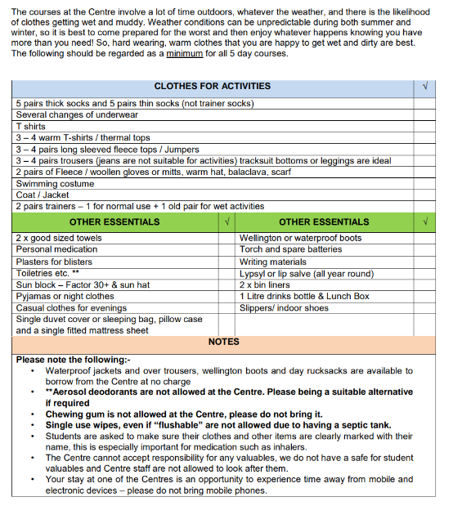
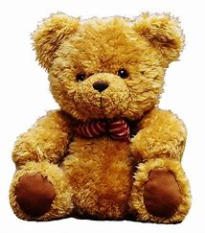
Kit list
Please can the students pack the bags themselves!
Packed Lunch for day 1.
Indoor shoes – slippers/sliders
Period products of children who may need them (we will have our own supply too)
Don’t forget me!

Slide 12
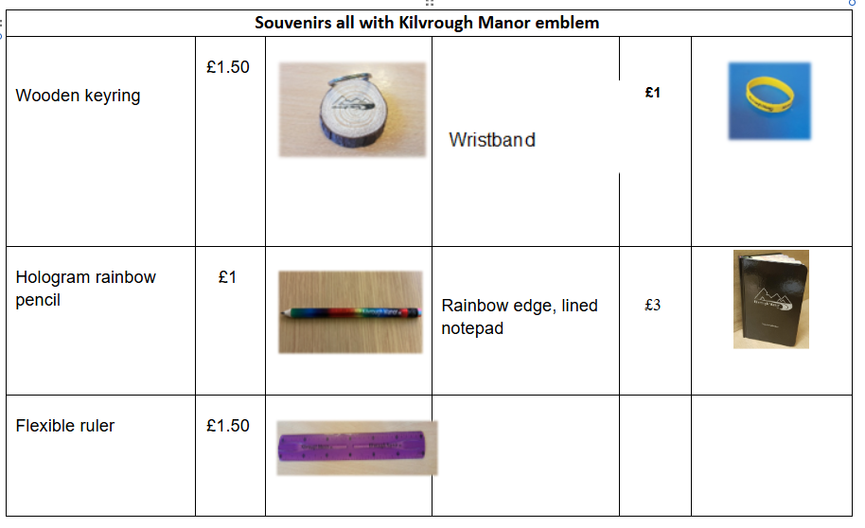
Shop! £5 only please

Slide 13
NAME EVERYTHING

Slide 14
Contraband
Electronic games
Mobile phones
Hair straighteners
Make up
Expensive watches/ Smart watches- these may get scratched during the activities.

Slide 15
Coming soon...
Via Parentmail to include information from today, a copy of full kit list.

Slide 16
Questions – you can stay behind to chat

