Slide 1
Parents meeting
Kilvrough!
Marcham Church of England (Voluntary Controlled) Primary School - Year 6 Kilvrough

Slide 2

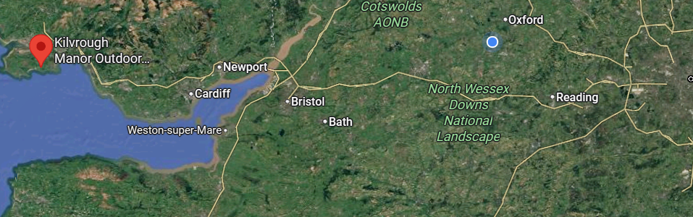
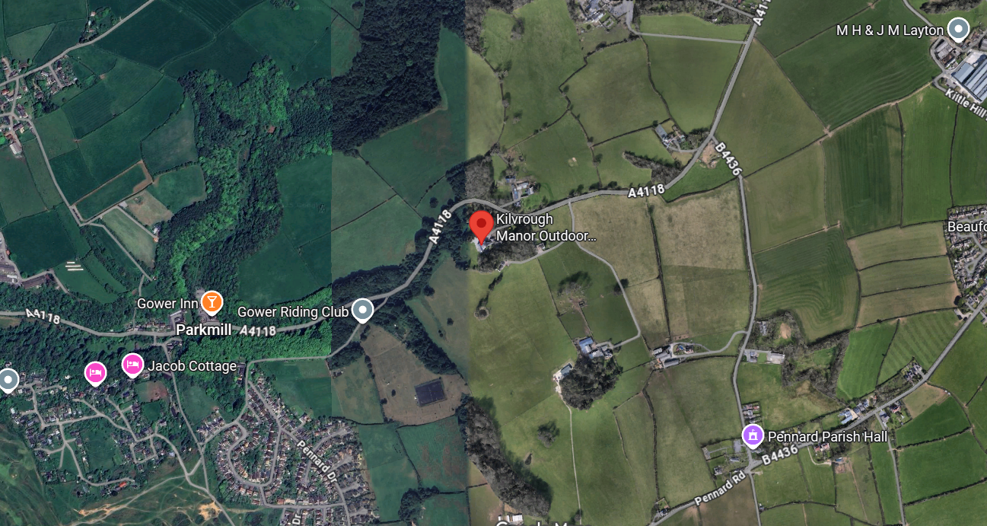
Where is Kilvrough?

Slide 3
Travelling
Travelling by coach on Monday morning leaving school at 7.45.
We will then go and collect the other school (Hanborough)
Home on Friday evening around 7pm- I will make a Dojo group and communicate through that.

Slide 4
Adults
Mr Clayton- trip lead.
Miss Priddle
Mrs Bone

Slide 5
Timings
Arrive at school on Monday morning at 7:30am
We will leave on the bus at 7:45am.
We pick up another school from Hanborough
We then leave Kilvrough at 3pm on Friday (just in time for rush hour!)

Slide 6
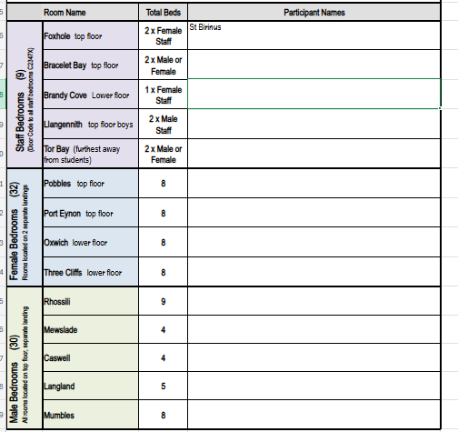
Rooms

Slide 7
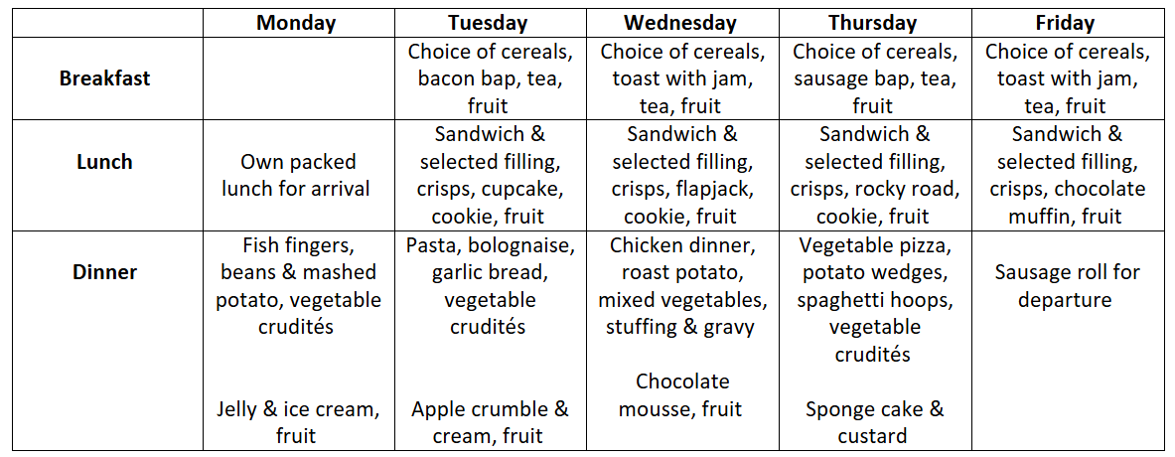
Sample menu - Food
Provided on site.
Previously enjoyed by the majority.
Allergies, vegetarian etc very clearly labelled.

Slide 8
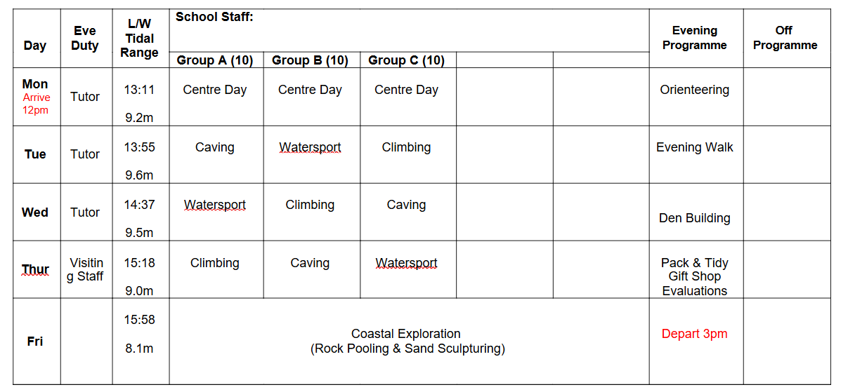
Timetable of activities - example

Slide 9
Communication
We will contact the school regularly who will share updates via class dojo where I will set up a year six group.
We will share more pictures after the event.
In the case of an emergency or accident we will contact you.
If there is an emergency and you need to contact us, please go through the school office as normal.
OR I will still be getting emails and Dojo’s and will check them once a day – if there is something which you think we need to know – phone the office first and then email.
J.clayton@marcham.oxon.sch.uk
The number for contacting us in an emergency: 07940214403

Slide 10
Medication
Forms will go out asking for their emergency contact details and confirmation of any special dietary requirements/allergens and regular medication that may need taking.
Any prescribed medication that is stored in school will be taken with us - (eg epi pen/inhalers).
Any other prescribed medication that that the children take regularly at home, that is not stored in school will need to be handed in on the morning and a form from the school office completed.
As staff, we will have emergency Calpol/Paracetamol with us - we will ring you for permission if we feel a child needs some.

Slide 11
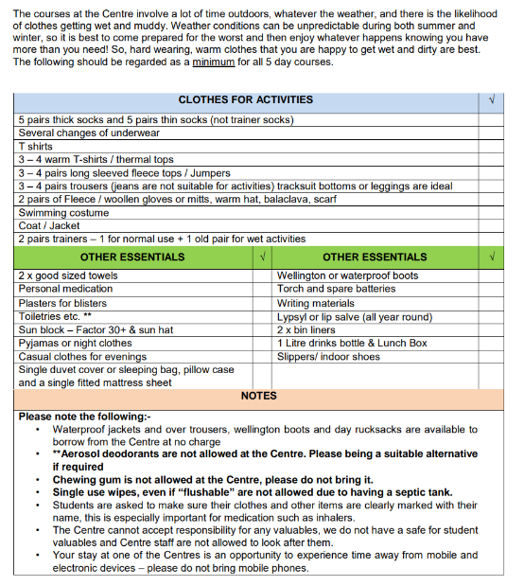
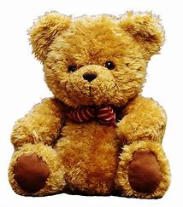
Kit list
Please can the students pack the bags themselves!
Packed Lunch for day 1.
Indoor shoes – slippers/sliders
Period products for children who may need them (we will have our own supply too)
Don’t forget me!

Slide 12
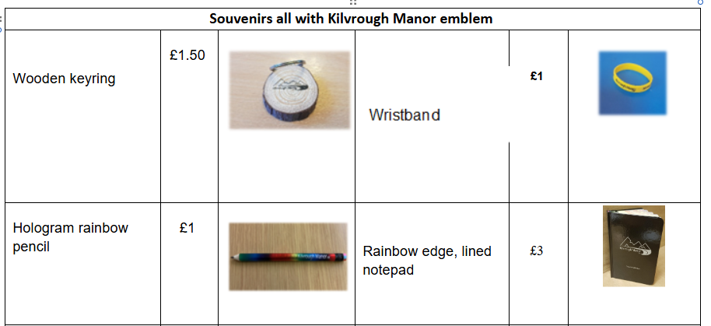
Shop. Please complete the order slip and have exact change. Return this to Mrs Wood in the office as soon as possible.

Slide 13
NAME EVERYTHING

Slide 14
Contraband
Electronic games
Mobile phones
Hair straighteners
Make up
Expensive watches/ Smart watches- these may get scratched during the activities.

Slide 15
Coming soon...
Via Arbor to include information from today, a copy of full kit list.

Slide 16
Questions or you can stay behind to chat

