Slide 1
Marcham School’s approach to writing
Writing – Getting it right…
With acknowledgement to Hampshire Improvement and Advisory service

Slide 2
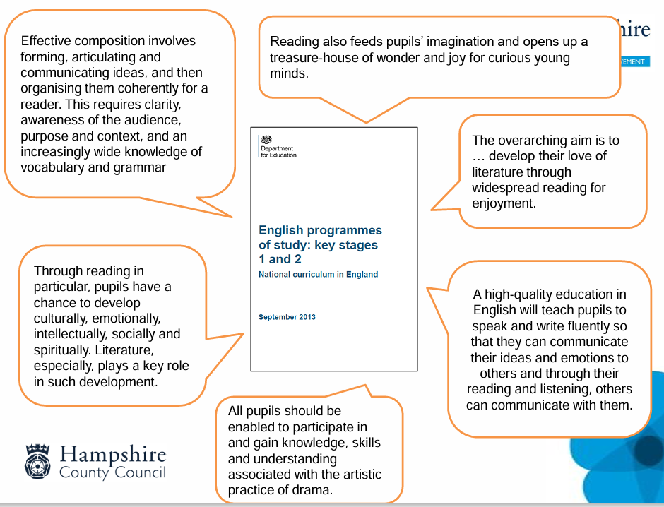

Slide 3

Reading…
Reading critically is about pupils’ understanding of the purpose and impact of the written word.

Slide 4

Talk…
It’s the route through which effective language and communication develops.
“Reading and writing float on a sea of talk.”
James Britton (1976)

Slide 5
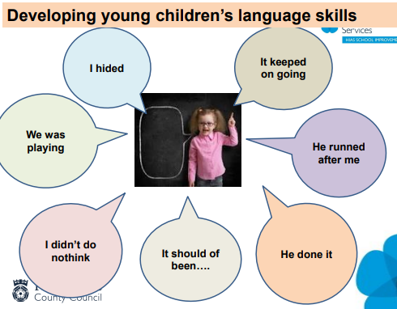

Slide 6
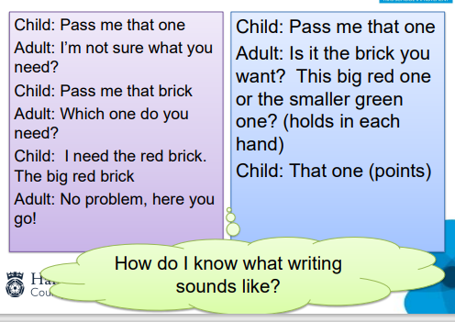

Slide 7
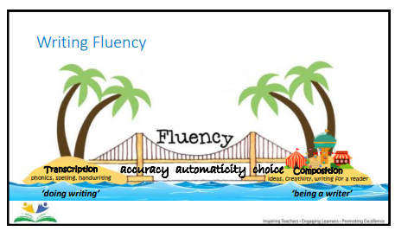

Slide 8
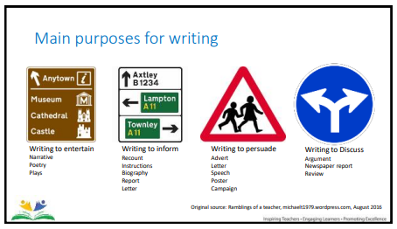

Slide 9

Hampshire English approach
Reading as a Reader
Reading as a Writer
Writing as a Writer

Slide 10

Drawing Club – Reception and Year 1
Stimulus
“A sea of talk”
Drawing
Writing

Slide 11
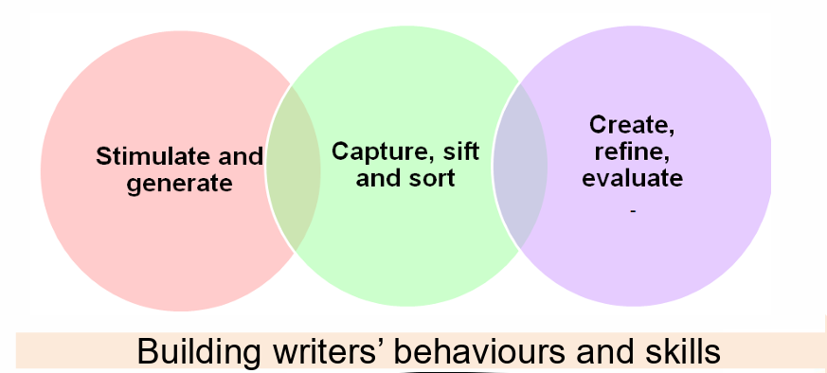

Slide 12
Stimulate and generate
Exploration of and practical approaches to:
➢ developing talk and spoken language to support writing
➢ vocabulary development techniques
➢ drama, role-play and oral rehearsal
➢ effective ‘hooks’ and writing stimulus
➢ clarity of audience, purpose, form and viewpoint.

Slide 13
Why?
To hook and engage the children into the literary driver
To develop empathy with the character/ events/ topic
To bridge the knowledge gap (both vocabulary and content), enabling all children to access the text.
- What additional knowledge do they need in order to be
successful?
- What ‘pre-teaching might some children need?
To stimulate vocabulary needed to enhance the final write – “warming up the words…”

Slide 14


Slide 15

Activity 1

Slide 16
Possible questions
What can you see?
What do you think is happening?
Who does the giant translucent leg belong to? I wonder what the rest of it looks like?
Why didn’t Matt Rockefeller show the whole character?
Where did they come from?
What are they doing here?
Why are the boy and girl following?
Who is more interested in following? How do you know?
Why are they running?
How did they meet the giant character?
Is this character a friend?
Where are they going?
What will happen next, and after that?

Slide 17
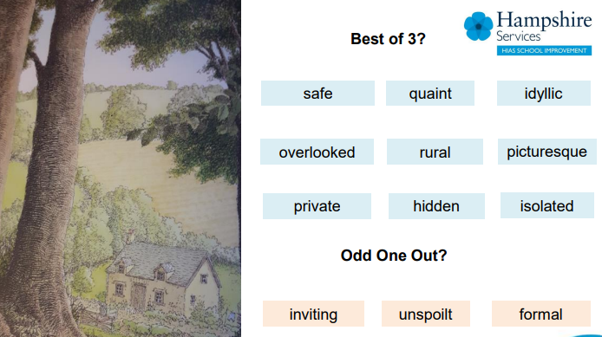

Slide 18
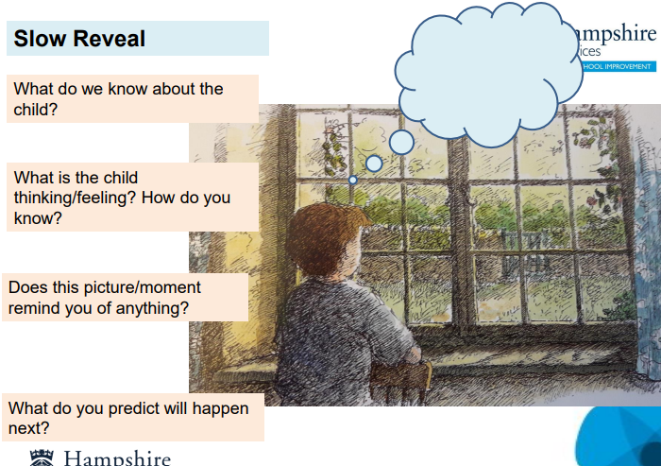

Slide 19
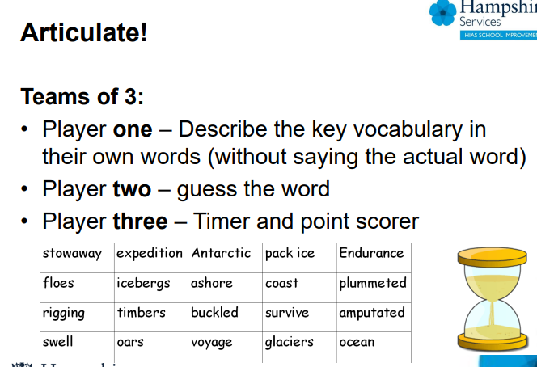

Slide 20
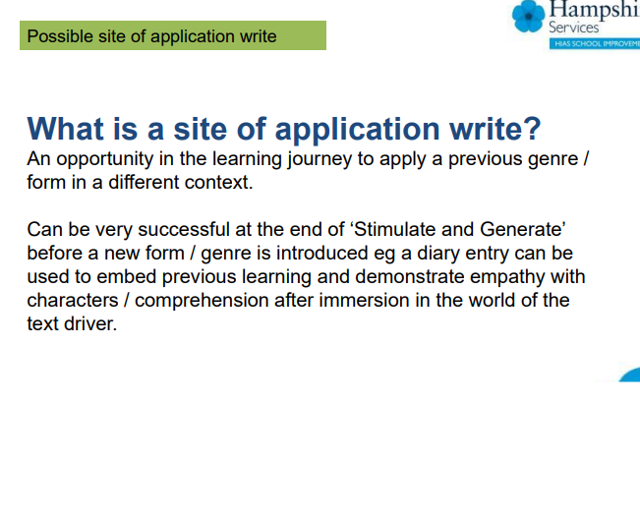

Slide 21
Capture, sift and sort
Exploration of and practical approaches to:
➢ pupil planning techniques
➢ teaching grammar and punctuation in context
➢ effective task design
➢ modelled, guided and shared writing

Slide 22
Why?
To explore writer’s conventions and craft – how they do what they do.
To develop the explicit skills necessary for the types of writing being explored.
To model, guide and share writing.
To practice and play with language at all levels.
To build confidence as children begin to think as writers.
To consider appropriate planning formats.

Slide 23
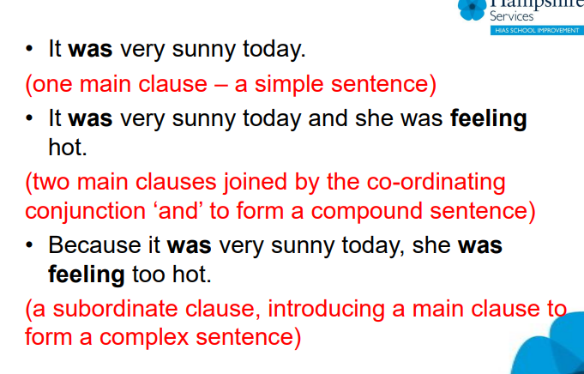

Slide 24
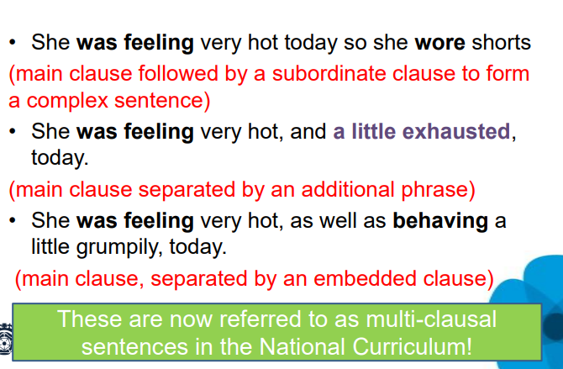

Slide 25
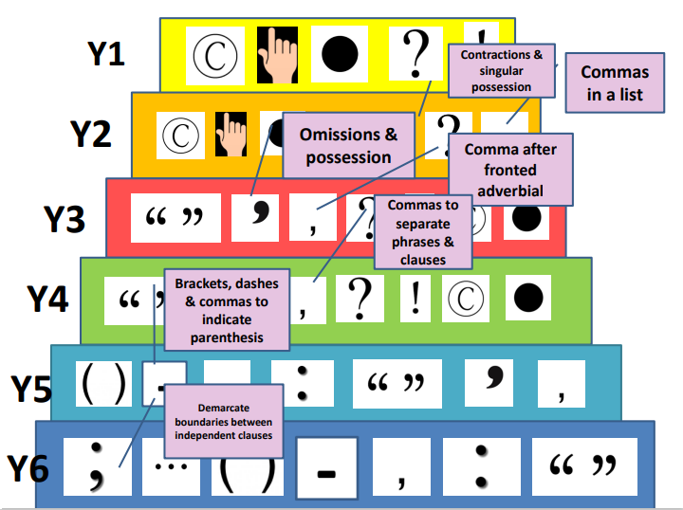

Slide 26
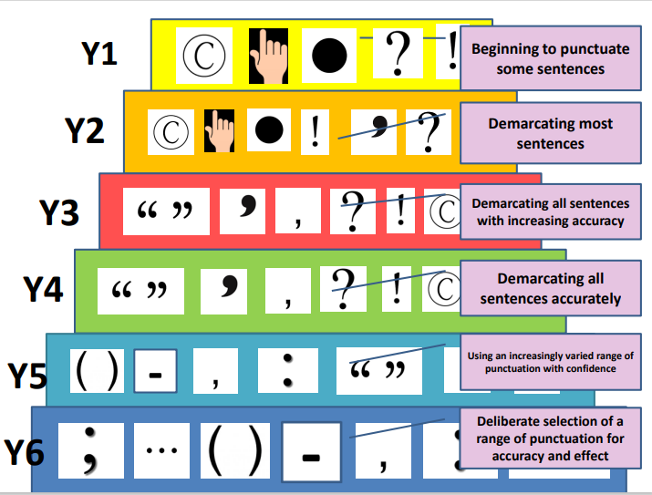

Slide 27
Activity 2

Slide 28
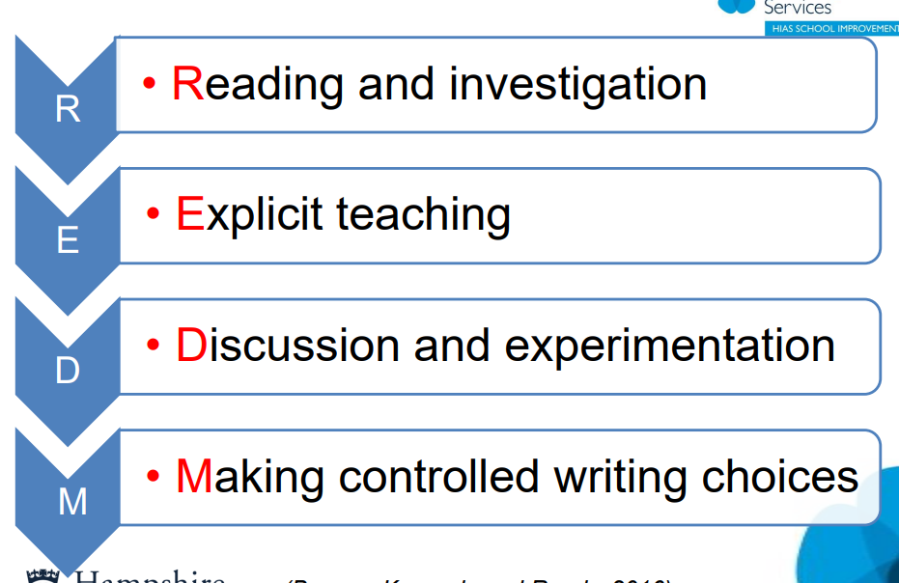

Slide 29
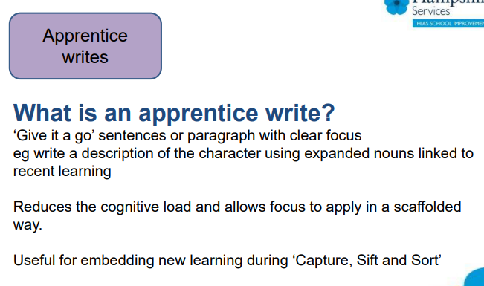

Slide 30
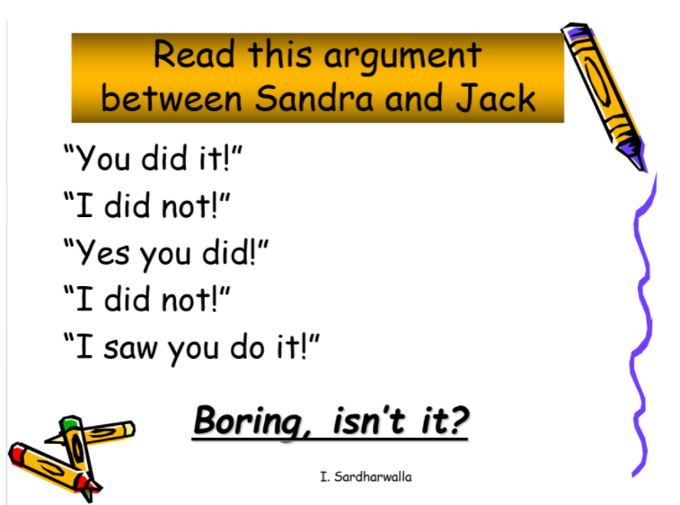

Slide 31
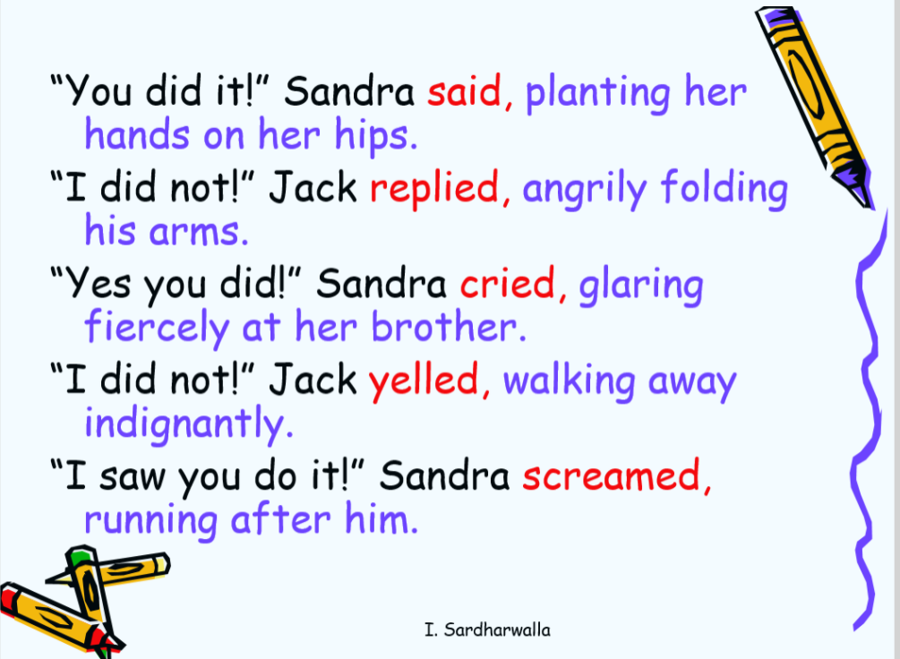

Slide 32
Task- in your narratives, how can you improve your dialogue.
Can you upgrade your words for "said"?
Can you add to the characters actions during the speech?
Could you use adverbs or adverbial phrases?
  Example:
“So that’s where You-Know-Who –?"Hagrid stuttered worriedly.
“Yes, but I can’t remember it," Harry responded urgently.

Slide 33
Create, refine, evaluate
Exploration of and practical approaches to:
➢ writing composition
➢ proof-reading, editing and evaluation

Slide 34
Why?
To follow a plan
To independently demonstrate genre, form and author’s voice.
To apply skills learnt to create a sustained writing outcome.
To refine and draft through proof-reading and editing.
To evaluate and reflect through agreed success criteria.
To publish and present outcomes.

Slide 35
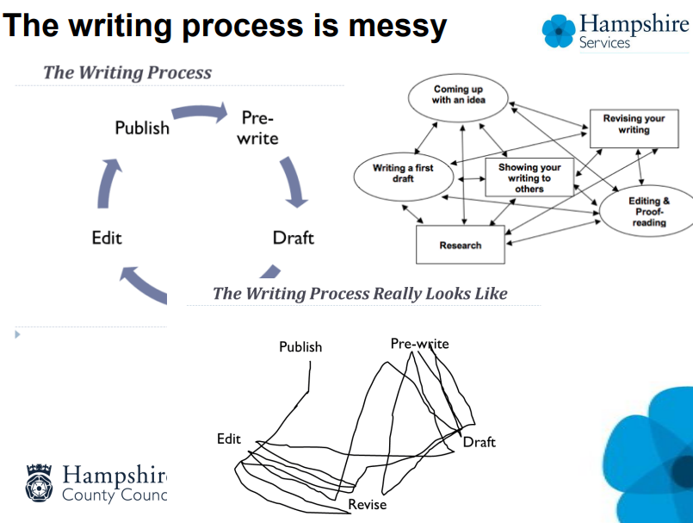

Slide 36
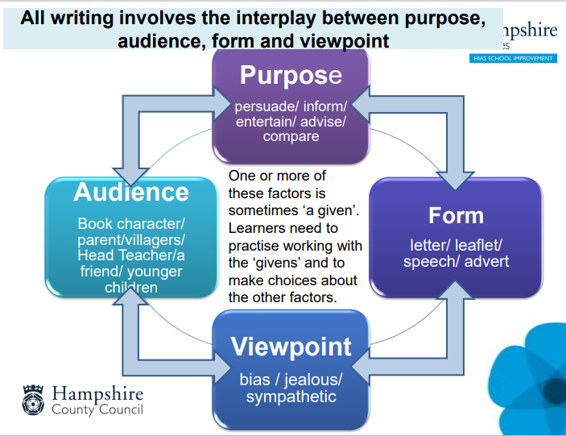

Slide 37
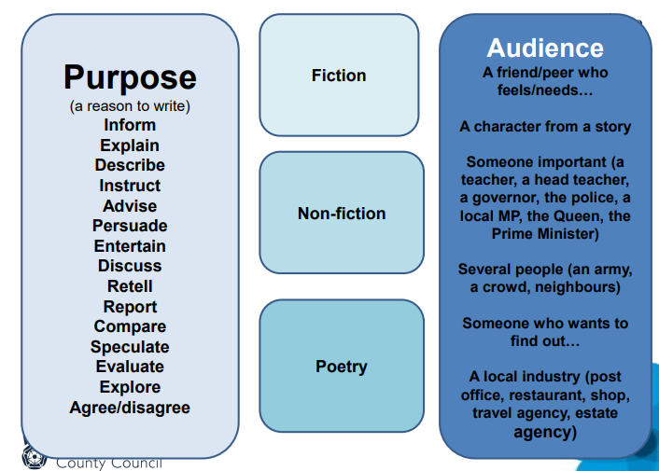

Slide 38
Activity 3

Slide 39
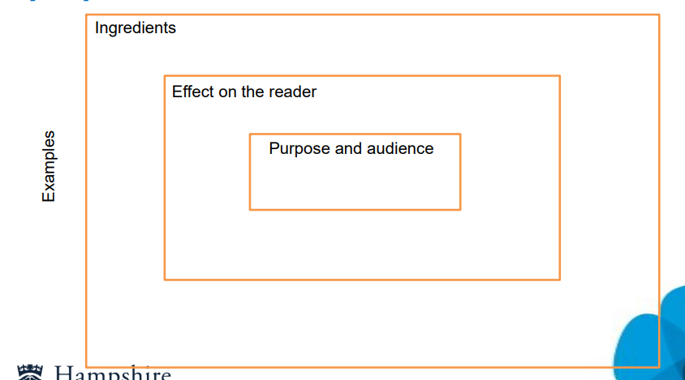

Slide 40
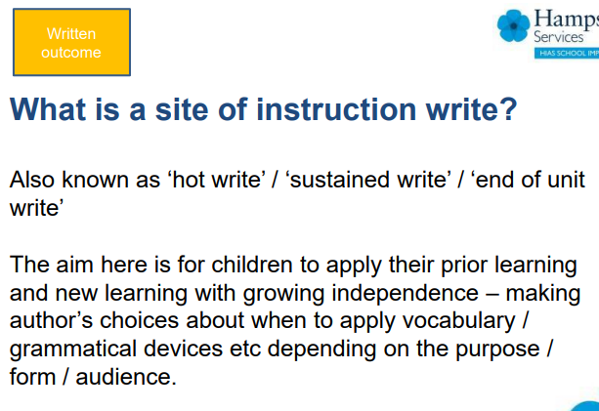

Slide 41
What will you do?
What impact has today’s session had on you? What will you do as a result?

