Slide 1

Phonics and Reading Information Evening
21st February 2024

Slide 2

Thank you for your attendance. Being here today or reading this presentation at home indicates that you share our passion for reading and recognise the life-changing impact that being a fluent and critical reader has on our children.

Slide 3
Agenda
What is the current thinking and practice surrounding reading in schools
Why does Reading matter?
What is a Systematic Synthetic Phonics Scheme and why do we use one?
What is Rocket Phonics?
What does a typical teaching week look like?
The Phonics Sounds Phases
Logging in at home – how to access books and end of unit quizzes
Cuddle-up books
Top tips for supporting Reading at home

Slide 4
Context
In 2007, the Government published the ‘Letters and Sounds’ handbook which has formed the basis for the teaching of Phonics in primary schools for the past decade or more. From September 2022, this handbook has been removed because it isn’t a full Systematic Synthetic Phonics (SSP) programme and doesn’t provide the support, guidance, resources or training needed. Rather, it relies on schools to build a programme and resources around the handbook. Additionally, many of the resources that schools have created require updating to bring them in line with current best practice.
Schools are required to take an approach to the teaching of phonics that is rigorous, systematic and used to fidelity, meaning that any resources should match the Grapheme Phoneme Correspondence progression of the chosen SSP. We believe that Rocket Phonics offers an excellent programme that achieves these aims and has the advantage of offering a range of high-quality progressive reading materials from Years R all the way through to Year 6.

Slide 5
Why reading matters
I realized in a whiplash burst that those children, all mine for one year, might never reach their full potential as human beings if they never learned to read.
Maryanne Wolf’s sudden awareness, as a new teacher, of her responsibilities towards her young class highlights why reading matters. To the individual, it matters emotionally, culturally and educationally; because of the economic impacts within society, it matters to everyone.

Slide 6
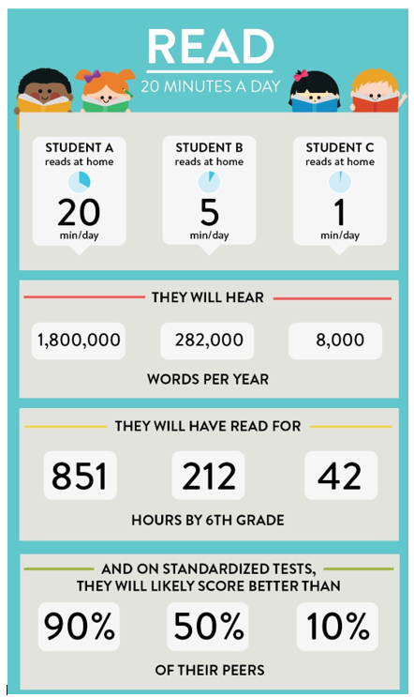
The stats speak for themselves

Slide 7

What is Systematic Synthetic Phonics (SSP)
Systematic Synthetic Phonics is a way of teaching children to read, write and spell. The sounds that children learn are taught in a specific, systematic order (not alphabetically) so that children can begin to build words from these sounds as early as possible.
Phonics supports children to hear, identify and link the sounds that letters make (phonemes) to what the letters look like when written down (graphemes). This helps children to recognise and read words, using knowledge of the sounds to read new or unfamiliar words.
(5.08mins in)

Slide 8
What is Reading Planet Rocket Phonics?
Rocket Phonics is a Systematic Synthetic Phonics programme that supports your child to learn all the skills needed to successfully read, write and spell. It is part of the Boost Reading scheme.
Within the programme, there are lots of beautifully created and engaging resources such as flashcards, sound mats, and online, interactive Big Books and quizzes to develop learning further. There is also a fully matched series of decodable reading books from a variety of genres, which will be used in class as well as sent home for home reading.
These books can also be accessed on the online platform to read as eBooks.

Slide 9
In their Rocket Phonics lessons, your child will learn to recognise, identify, say and read all of the 44 sounds of the English language along with writing and spelling them.
They will revisit sounds they have learned, learn new sounds, take part in stimulating activities to practise and apply their reading, writing and spelling skills.
At the end of a text, they will complete comprehension quizzes to check for understanding.

Slide 10
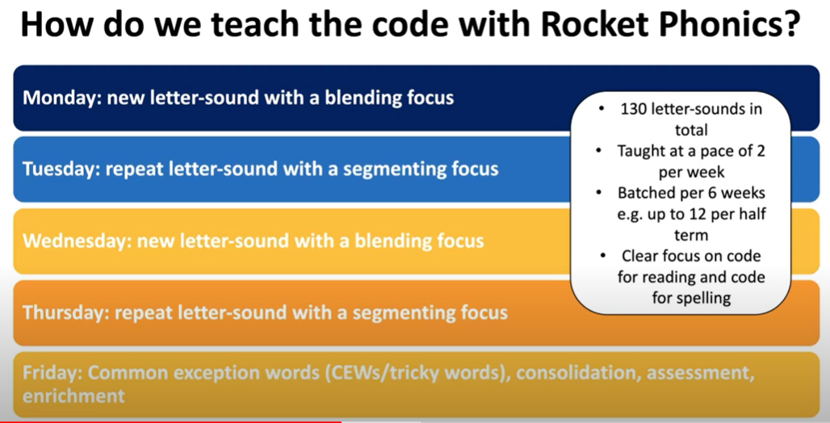
A typical teaching week
Share what we do with reference to the resources.

Slide 11
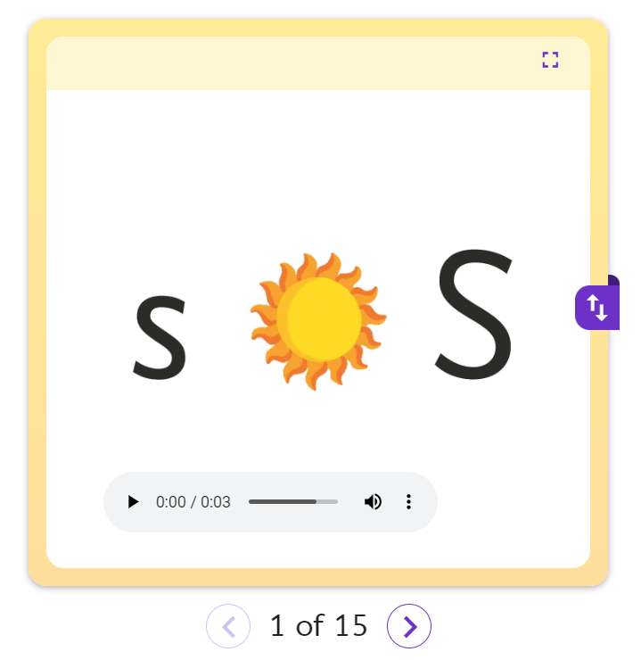
New sounds are introduced using interactive flashcards
https://my.risingstars-uk.com/html5_renderers/LaunchRHResource.aspx?resourceGUID=da98082a-95f8-4f2c-81b8-4d9746a3d4dd&courseGUID=a7273eab-570d-49cb-9455-db5631042e60

Slide 12
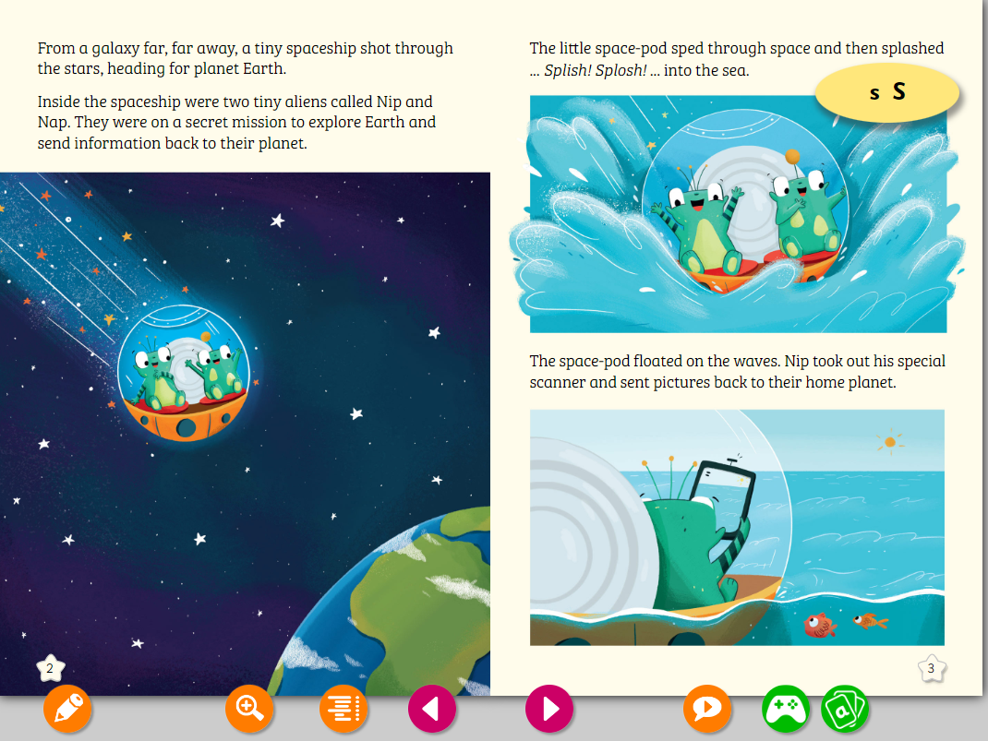
Monday: Introduce a new letter sound with a blending focus.
Pupils then see and hear the new sound, in this case ‘S, through the Big Book.
The sound is used frequently within the text.
Pupils join in, saying the new sound when they encounter it in the peach lozenge.

Slide 13
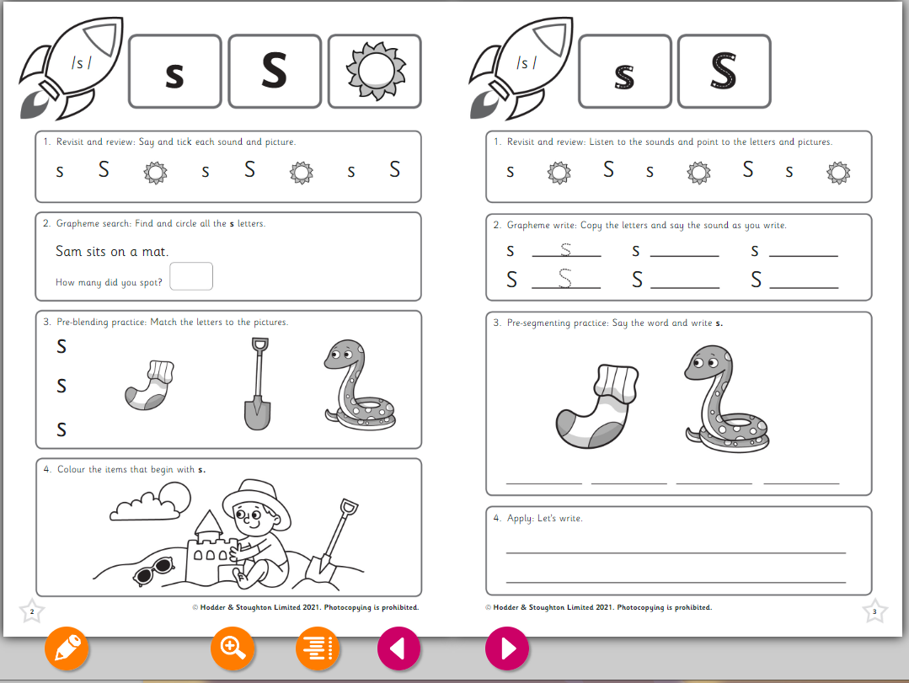
Tuesday: Repeat letter sound with a segmenting focus.
Accurate letter formation is taught for both upper and lower case letters. Additional handwriting opportunities are provided at other points in the week.
Pupils practise the sound they were introduced to in the previous lesson, segmenting for spelling and using the sound in their own writing.

Slide 14
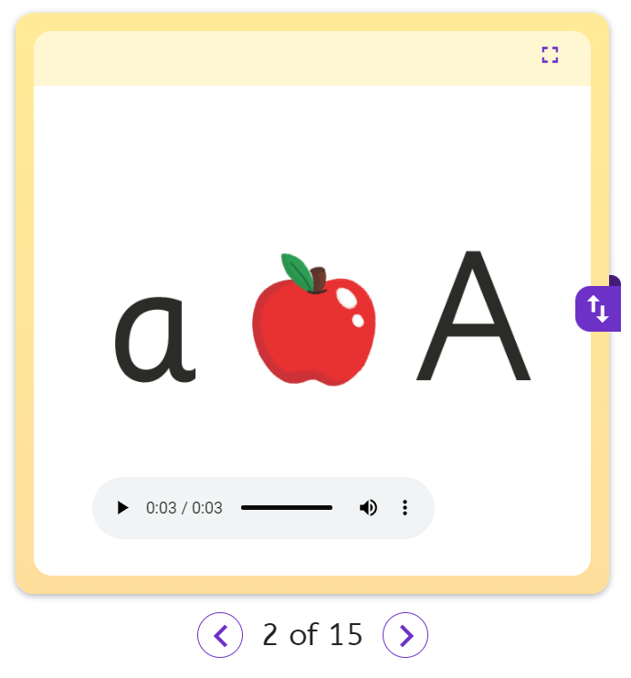
New sounds are introduced using interactive flashcards
https://my.risingstars-uk.com/html5_renderers/LaunchRHResource.aspx?resourceGUID=da98082a-95f8-4f2c-81b8-4d9746a3d4dd&courseGUID=a7273eab-570d-49cb-9455-db5631042e60

Slide 15
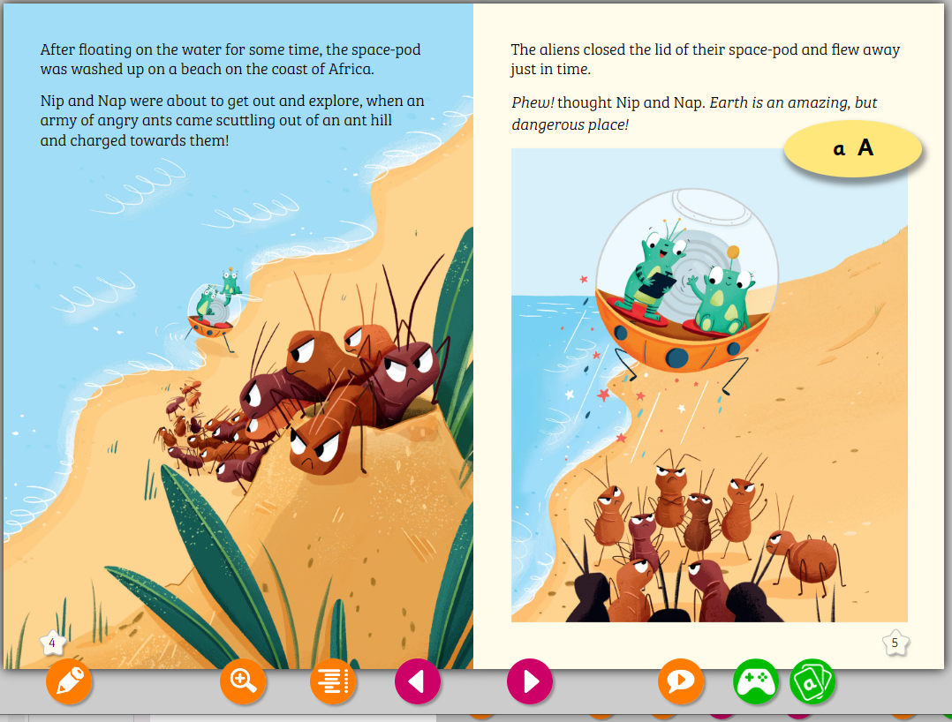
Wednesday: Introduce a new letter sound with a blending focus.
Pupils are introduced then see and hear the second sound, of the week through the Big Book.
The sound is used frequently within the text.
Pupils join in, saying the new sound when they encounter it in the peach lozenge.

Slide 16
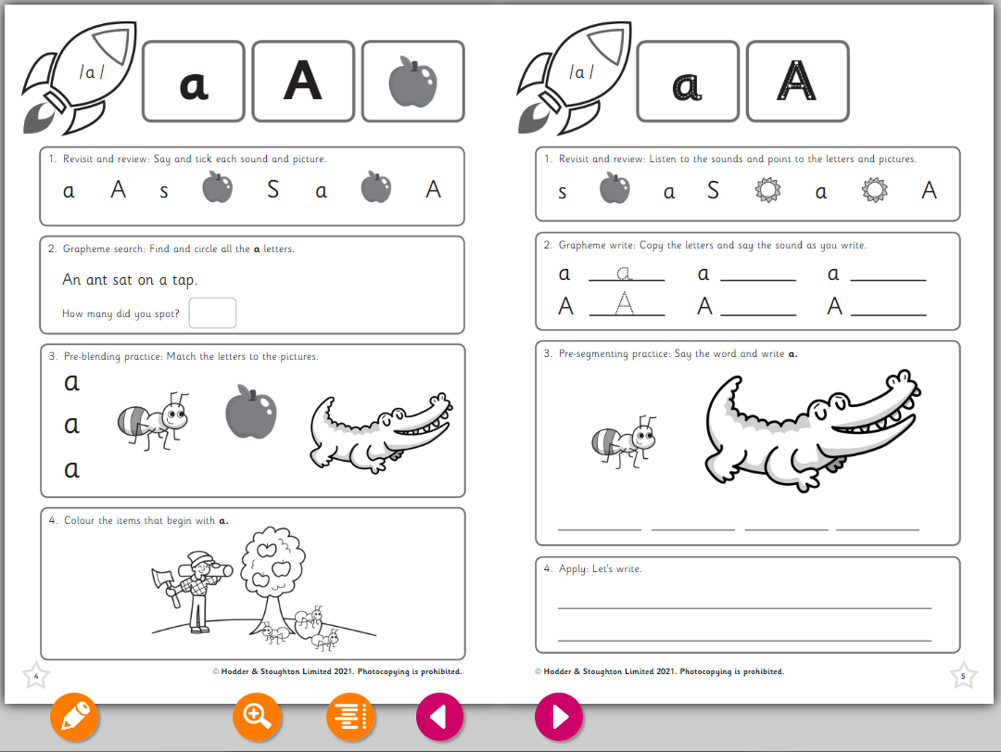
Thursday: Repeat letter sound with a segmenting focus.
Accurate letter formation is taught for both upper and lower case letters. Additional handwriting opportunities are provided at other points in the week.
Pupils practise the sound they were introduced to in the previous lesson, segmenting for spelling and using the sound in their own writing.

Slide 17
Friday: Flexible learning day.
This is a flexible day where the current needs of the children can be met in a variety of different ways, such as:
Teaching and practising ‘tricky’ words
Opportunities to use prior learning in games and puzzles
Chance for teachers to revisit prior learning with target groups
Assessment

Slide 18
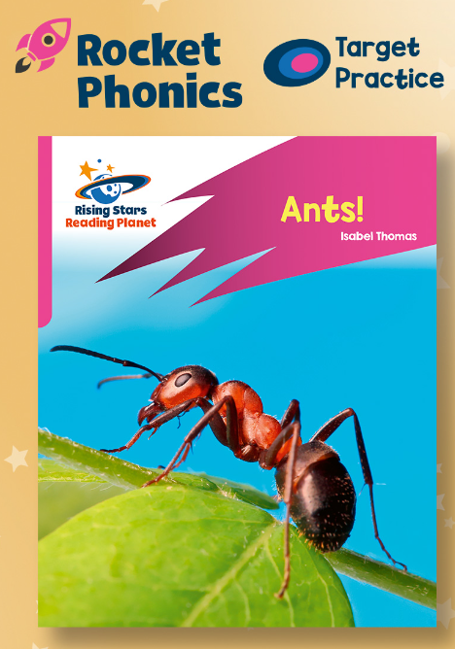
The Phonics Sound Phases
Sounds are introduced in phases, meaning it can take several weeks for a phase to be fully introduced. Children will not be allocated a reading book at home at a particular phase until all of the sounds in that phase have been explicitly taught and practised at school. When a book is allocated, your child then has all of the skills necessary to read that book. As a result, your child will continue to read books in a given phonics phase for several weeks. This may seem odd to you. However, please be reassured that overlearning and revisiting helps to embed new learning. Whilst continuing to practise these sounds at home, your child will also be accessing sounds from the next sound phase at school and practising these in target practise reader books in class reading sessions.

Slide 19
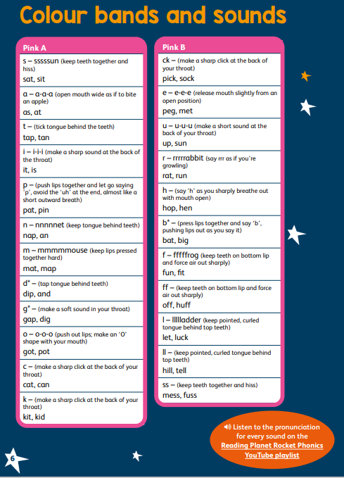
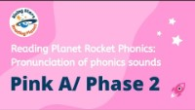
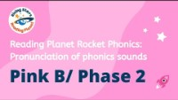

Slide 20
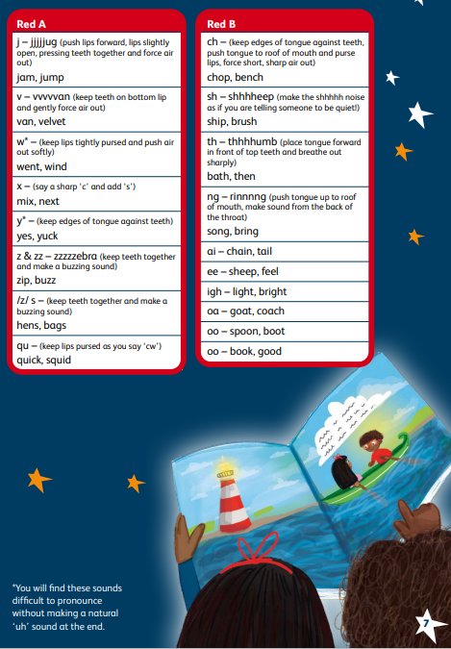
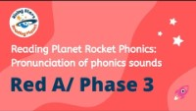
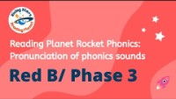

Slide 21
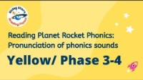
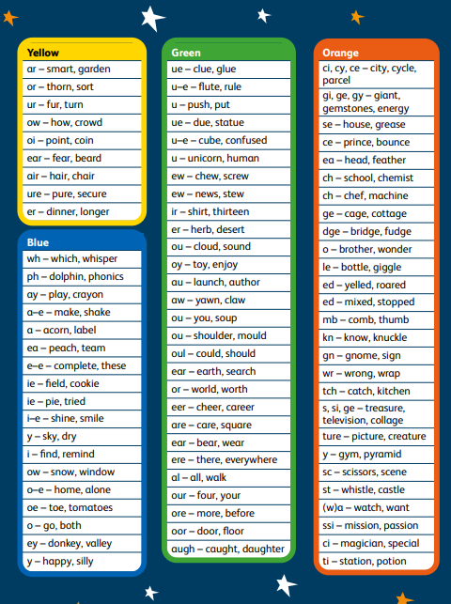
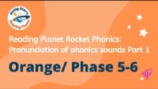
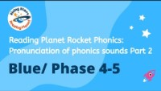
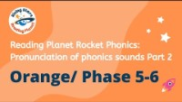
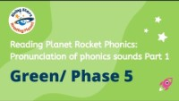
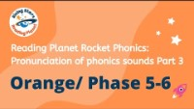
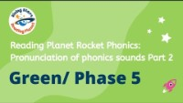

Slide 22
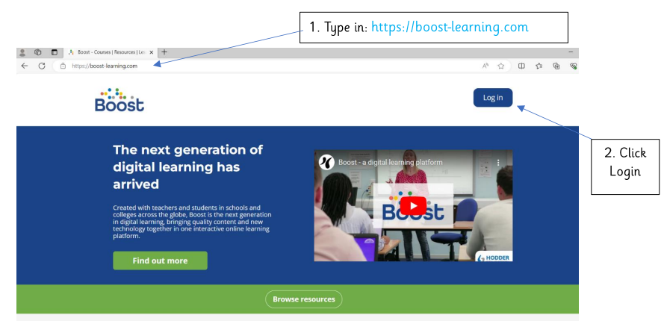
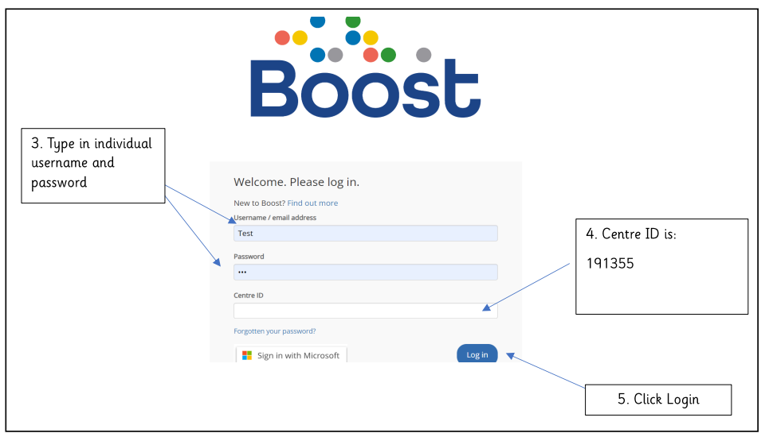
Logging in at home
Your child will be set a reading book that they will need to access remotely at home. To do this you will need:

Slide 23
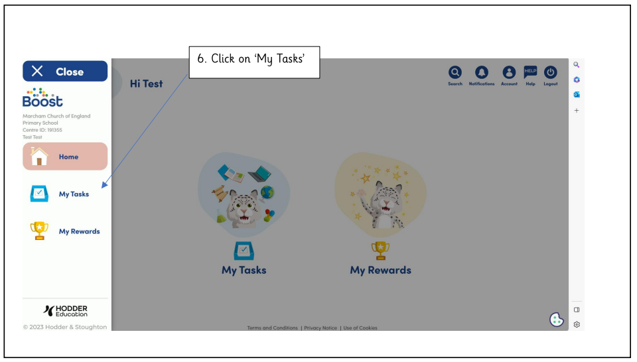

Slide 24
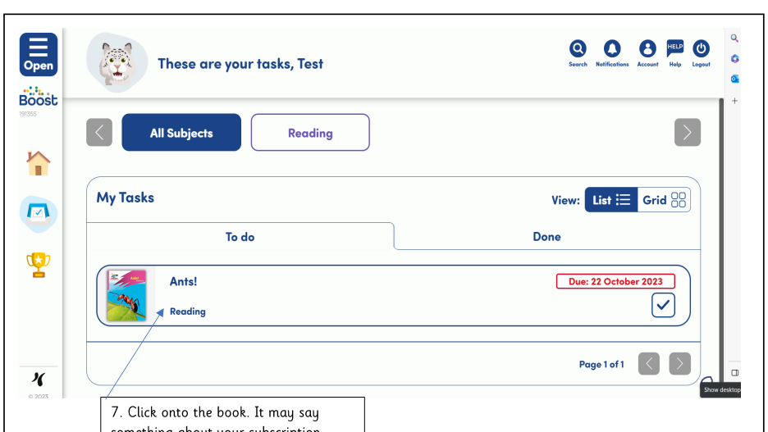

Slide 25
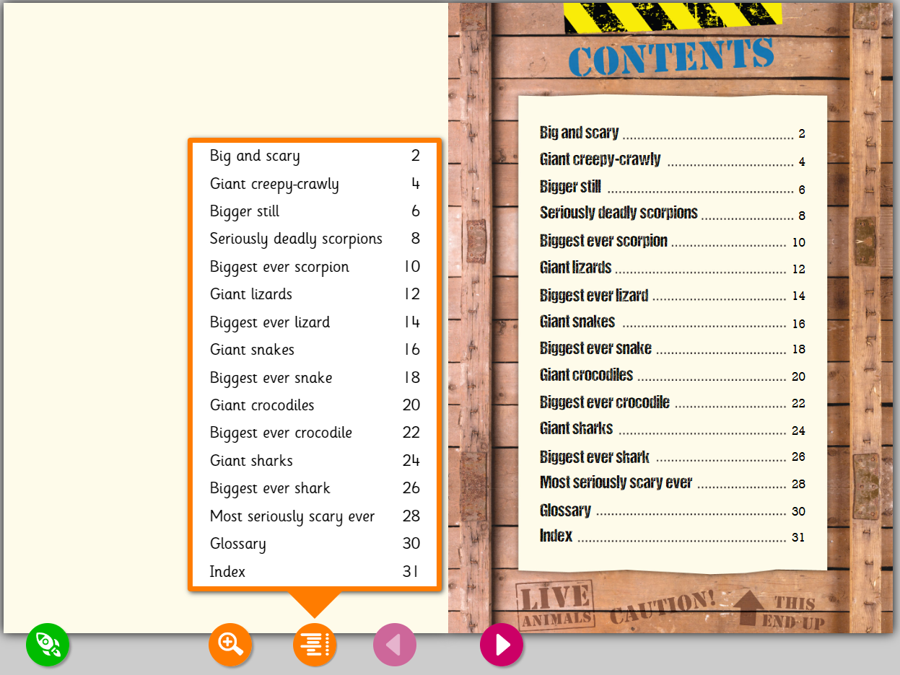
Select the chapter or pages your teacher has asked your child to read either by accessing the chapter list or using the pink forward tab.

Slide 26
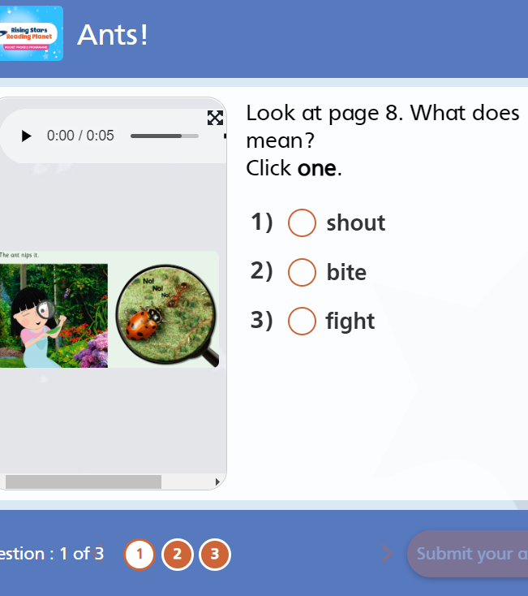
End of Book Quizzes
On completing a text, your child will be prompted to take a quiz, which assesses their understanding of what they have read. The results of the quiz appear in ‘My Achievements’ section of their profile and provides an insight for the pupil, their parents and their teachers about how well they understood what they read.

Slide 27
Cuddle up books
Teaching children to recognise sounds, to blend for Reading and to segment for Writing are essential in enabling them to become successful and independent learners. However, we recognise that fostering a life-long love of Reading requires many tools. At school, we share a rich and varied diet of texts with your children and we encourage you to do the same at home.
Find time regularly to cuddle up with a book and to make this a treasured time in your day. In addition to a Reading Planet text, your child will also bring a ‘Cuddle Up’ book home. They won’t be able to read all of the words but do take time to read to them, to allow them to join in when they can and to talk together about the text. We will be providing a variety of question prompts on a bookmark to support you with this.

Slide 28
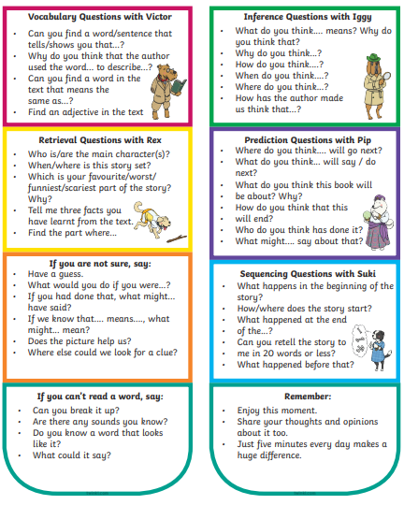
Year 1 Bookmark (example)

Slide 29

Top Tips For Supporting Reading At Home

Slide 30
1. Read As Regularly As You Can At Home
Reading at home is as important as reading at school. It gives children a chance to practice (which is always a good thing!) and the opportunity to develop a language-rich environment at home.
Read to your child. This may sound obvious but showcasing your love of reading and giving your child the opportunity to listen to you read is just as valuable as them reading to you. Some parents may think that reading at home is all about hearing your child read, which is a very important part of developing their reading skills, however allowing them into your world of reading creates a new, exciting experience that will boost their love of books.

Slide 31
2. Build Reading Into Your Child’s Daily Routine
Find a regular time for reading in your child’s day, so that they can start to expect it as part of their regular routine. It can be any time: before bed, after dinner, or in the morning after breakfast when they have more energy.
Don’t get caught up with how much time your child spends reading – if they need a break that is completely fine! Reading can require a lot of mental effort and stamina, especially during the early stages and we don’t want to ‘put children off’ by forcing them to continue reading when they need a rest.
Your child doesn’t need to read an entire book in one go. Taking regular breaks will give your child a chance to gradually build their reading stamina and soon they will be able to read for longer.

Slide 32

3. Encourage A Range Of Reading Materials
Don’t feel like your child only has to read books. They can read anything and everything – get creative! Magazines, newspapers, recipes, game instructions – the list is endless!
When you are out and about there are so many things that we read automatically and successfully using our reading skills without even realising
Encourage your child to read things like road names and signs, shop names, bus and train timetables, posters and leaflets. This will support your child’s application of the sounds that they know to real life.

Slide 33
4. Develop Your Child’s Love of Reading
Give books as presents
Encourage your child to organise book swaps with friends
Visit the local library or book shop together regularly
Have a family bookshelf and start a family book club
Alternate between print books and eBooks
Watch the film version once your child has read the print version
Mix it up: read non-fiction books as well as fiction books

Slide 34
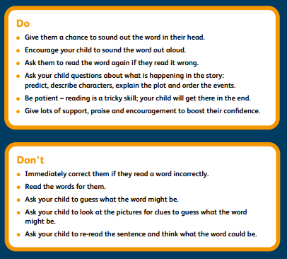

Slide 35

Thank you
Thank you for attending.
If you do have any questions, please do ask your class teacher.
This PowerPoint will be available on the school website for you to refer to at home and as your child continues to progress on their reading journey.

