Slide 1


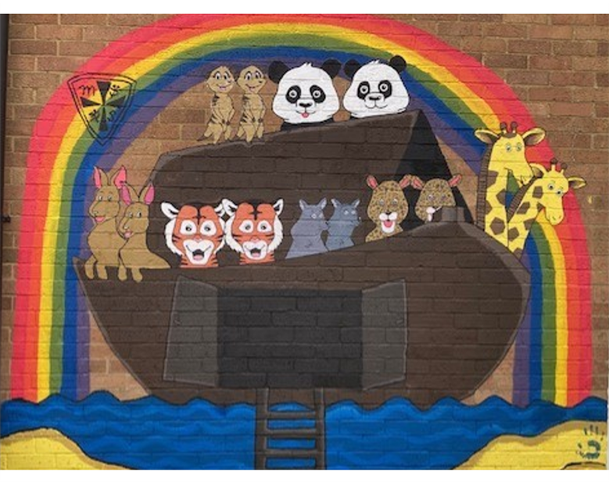
Marcham Primary School ​
NewsletteR
Marcham CE Primary School​
Morland Road, Marcham​
Abingdon, Oxon OX13 6PY ​
Tel; 01865 391448 ​
or email on; office.3235@marcham.oxon.sch.uk​
​
"Living and learning with Faith, Community and Hope."
Our value this term is Responsibility
Whatever your hand finds to do, do it with your might. Ecclesiastes 9 v 10
17th March 2025
Dear Parents/Carers,
Isn't it lovely! Spring is really beginning to put in an appearance and, with the days lengthening and the weather getting brighter, it makes everything seem just a bit jollier. I am hoping that you are having opportunities to take in the beauty of the season as daffodils, primroses and crocuses are out and the buds are appearing on the trees.
New Headteacher!
First and foremost, I would like to congratulate Miss Priddle on her appointment as the Headteacher of Marcham School from September 2025. I am absolutely delighted for her and for the school. You will have been informed of her years of experience as a school leader in the letter sent to you by the school Governors earlier this week, and we are very lucky to have someone who really understands how schools work. But more than that, she understands how Marcham School works and shares its vision. She has a passion for its development, and I know that she has plans for moving it on from strength to strength.
It is all very exciting - and we look forward to a very bright future for Marcham School. Hurrah!
Pupil attainment and progress
It has been assessment week this week in school and the children have been busy, using these opportunities to prove just how much they have been learning and showing us what they can do. It is our Parents’ Evenings next week. I do hope that you have been able to book a time to speak with your child’s class teacher. Being just over half-way through the school year, it’s a good time to have a review of how your child is getting on and to discuss with you what you can do to help at home. For those of you who have not yet booked a slot, please see this as a gentle reminder that you need to do so. I am sure that you are keen to see how your child is progressing and this home/school link is vital to our working together to secure the best outcomes for our children.
“The Life of Christ”– Hanney Baptist Church
Following the dramatic representation of “The Life of Christ” for our KS2 pupils a couple of weeks ago, we received the results of the competition. Each child received a box of Maltesers for their efforts. The children, for the most part, worked in pairs. Here are the winners:
Year 3 – Ianis and Megan
Year 4 – Paul
Year 5 – Naia and Clara
Year 6 – Tom and Ben
Well done to all our winners. I am hoping that you will be able to share some of the stories you heard with someone at home – even if you don’t share the Maltesers…
20th September 2024

Slide 2
Learning of the Week
Pandas
In Pandas this week, we have been learning to measure length and time. We created our own obstacle courses and timed how long it took each other to complete them! We've been reading Jasper's Beanstalk and have been learning about how plants grow. We have also learnt the tricky words 'all' and 'are’.
Leopards
Leopards have been busy learning how to measure during Maths - we have been learning to measure
using handspans, cubes and then moving on to measuring with rulers. During Topic and English we
have continued our learning about the polar regions. We found out about Captain Scott and how he
travelled to the South Pole. Forest school and Science has focused on the signs of Spring - the
beautiful sunshine has really helped us find lots of blossom, new shoots and ladybirds.
Tigers
Since writing about pirates, the Tigers have been writing about fantastical creatures on islands and under the sea inspired by some great stories. They explored the strength of paper in a very hands-on Science lesson. In Maths, we have started measuring in centimetres and metres. Nearly the whole class had managed to interview their parents or grandparents about seaside holidays in the past and they bravely shared their research and photos with the class. Thank you to all the adults who facilitated this historical experience. In RE, Jill led a great session on Shabbat for Tigers and Leopards. The children sampled her delicious homemade challah bread. Thank you to Jill for sharing her knowledge, experience and baking with the classes.
Kangaroos
This week, Kangaroos have been learning about the different events that took place during Holy Week. They have been writing biographies in Writing, and they have been learning how to multiply 2-digit numbers in Maths. In Geography, they labelled a world map to learn about the ring of fire.
Meerkats
In Meerkats, we have been learning how to represent decimal numbers such as 0.82 by shading in squares. We have also been identifying different types of triangles (equilateral, scalene, isosceles and right-angled) and quadrilaterals (rectangles, squares, rhombus, parallelogram, trapezium and kite) by using geoboards and rubber bands to make them. We have also been discussing smoking and vaping in our PSHE sessions. Our class assembly is on Friday 21st March.
Wolves
This week, we went on our Winchester Trip to the Science Centre. At the Science Centre, we explored the area. Then, we had a workshop where we looked at lights. After that, we went in the planetarium to look at the stars, planets and solar systems. This week we finished our planet writing unit. We made our own planets and wrote a diary about landing on them! We have also been looking at perimeter in maths! – Heidi
Giraffes
We went to the Living rain forest as we are learning about the rainforests. We learnt about lots of different animals that live there. The best bit was we got to see an armadillo which is my favourite animal. - Will
On Tuesday 4th March we went to the Living rain forest. We went because this is our class topic. We learnt a lot about the different animals that live in the forest. One of the facts I remember is about the monkeys. They are super crazy because they eat a lot of food. The best bit was the Sloth because it was really cute. - Fizz

Slide 3

Website
Take a look at our school website - we have shared some photographs from our recent World Book day. Take a look in our Whole School Events Page
Our recent SIAMS report can be found at https://www.marcham.oxon.sch.uk/siams/
Keep up to date with our School Calendar - you can assign to this for just your child's class.
Autism Terminology Guide – Why Words Matter
A useful guide written alongside young people with Autism. This highlights why words truly matter in education and in wider society.
Click the link to read more:
https://www.autismeducationtrust.org.uk/sites/default/files/2024-12/terminology_guide_-_why_words_matter.pdf
Bags2School Collection​
There will be a Bag2School collection on Tuesday 25th March at 9am. All proceeds will go into the Preschool-Foundation Partnership. Please drop items off, bagged, at the front of school on the collection day. Bags have been distributed this week, but bin bags can also be used.​
Please donate:
Clothes, paired shoes, handbags, hats, bags, scarfs and ties, bras, jewellery, socks and belts.
Please do not donate:
Duvets and blankets; pillows and cushions; carpets, rugs and mats; soiled, painted, ripped or wet clothing; school uniforms (with or without logos); corporate clothing or workwear, textiles, yarns or threaded material, furniture or large items; batteries. Thank you.
Diary Dates
 | Date | Event | Time
Tuesday | 25th March 25 | Parents evening | 5-8pm
Thursday | 27th March | Parents evening | 3:30-6pm
Monday | 31st March | Whole school skipping workshop
Friday | 4th April | Easter service, All Saints Church | 9:30am
Friday | 4th April | End of spring term | School finishes at 1:30pm
Attendance
Well done to Duffield House with the best attendance 3rd to 14th March 2025 .
Term 3 Tues 7th Jan to Fri 14th Feb 25 Mon 6th Jan 25 INSET day | Term 4 Mon 24th Feb to Fri 4th Apr 25
Term 5 Tues 22nd Apr to Fri 23rd May 25 Mon 21st Apr Bank holiday Mon 5th May Bank holiday | Term 6 Tues 3rd June to Tues 22nd Jul 25 Tues 2nd June INSET day
Anson 93.70% | Denman 89.16%
Duffield 96.51% | Morland 96.20%

Slide 4

Dear Parents, Carers and Friends,
The Parent Teacher and Friends Assocation (PTFA) is eager to learn more about our wonderful school community. Your feedback will help us assess the impact of our work and explore ways to encourage greater involvement.
We appreciate your time is precious and would be grateful if you could take a few moments to complete this questionnaire. Your responses will guide us in planning future events and initiatives that best serve our school and children.
As a thank you for your input, we’re excited to offer a prize draw for a bottle of wine! One winner will be chosen at random from each year group.
Please feel free to share any additional thoughts or reach out to a committee member if you have any questions or suggestions.
Thank you for your time and support! https://forms.gle/4F4gKqSJ4oeBZFj8A
Please note: This survey will close on Monday 31st March.
Kind regards - The PTFA committee
Come and buy nearly new school uniform in the school lobby.
The PTFA are selling off their remaining stock of second-hand uniform. They are displayed on racks in the School Reception area
KS2: Mon 10th March - Fri 21st March
Please pay what you can; suggested donation 50p - £1 per item.
We'll be setting up a new system for second-hand uniform so please do not bring any more donations to the school. Look out for information in the coming weeks.
Thanks - PTFA

Slide 5
Here are the results our Celebrations assembly awards.
Well done to all the recipients of these awards. Keep living the vision and exhibiting our learning behaviours.
 | “Living the Vision” award | “Excellence in Learning” award
Reception | Isla W | Oscar
Year 1 | Ed | Axie
Year 2 | Phoebe | Lottie
Year 3 | Alba | Casey
Year 4 | Alfie | Dexter
Year 5 | Miles | Paige
Year 6 | Jacob | Jerome
Report from Zoe Barnes
9 pupils in year 6 play for Marcham Colts FC U11s and they played in a cup final on Sunday 16th March. The game was really tight and the boys had to work hard, especially after they went 1-0 down late in the first half. Jacob scored a fantastic free kick to equalise in the second half and Benjamin made it 2-1 shortly after. Unfortunately for Marcham the opposition, Kennington, equalised before the end of the game so it went into extra time. It was a close battle with both teams defending well and creating chances but neither team could score. Therefore, the match went to penalties and Marcham managed to score all 5 of their penalties and as result, won 5-4 in the penalty shoot out to become champions! Jerome, Hunter and Benjamin from Marcham school were three of the penalty takers. The played with fantastic sportsmanship and made sure to shake the oppositions hands before properly celebrating the win! I am sure the trophy will make it into school!
The players from Marcham School are: Benjamin, Jerome, Jacob, Jamie, Hunter, Lucas F, Dyllan, Hugo and Ives.
Zoe – a really big ‘Thank you’ for all you do to support our children in their sporting endeavours. You are a star!

