Slide 1

Class Meeting for Parents
September 2026

Slide 2
Welcome to Wolves class!
We hope at the end of the meeting, you will:
Find out about our class;
Be aware of the class expectations;
Find out about our vision, values and learning behaviours;
Find out how you can help your child at home;
Have the opportunity to ask any questions you may have.

Slide 3
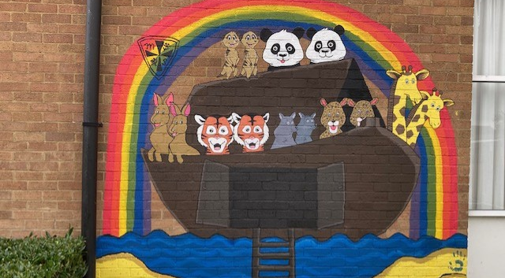
Living and Learning with Faith, Community and Hope
Notes:
A reminder of our school story and the words which summarise it: Living and Learning with Faith, Community & Hope.
Reminder of where it is and suggest that they look at it when next they go past. It was designed and painted by ex-pupils of the school.
Faith – achieving beyond our expectations, Community – everyone matters and belongs, Hope – making the world a better place.

Slide 4

Christian Values – these are the six values which underpin our ethos.
Notes:
Focus for collective worship each half term. Referred to in collective worship and class PSHE time.

Slide 5
Behaviour - Five principles of conduct that underpin practice for staff:
Consistent, calm, adult behaviour
First attention for best conduct
Relentless routines
The use of scripts for difficult interventions and conversations
Restorative follow-up
Notes:
More information about how we lead and manage behaviour can be found in the policy, which should be on the school website.
This leads us on the conduct in general and we thought it would be a great opportunity to remind of our Home-School Agreement, which you may remember signing some years ago.

Slide 6





Learning Behaviours
R
A
H
E
C
Notes:
We are keen to develop independent life-long learner and to encourage this, this year we will be focussing on 5 learning behaviours with the acronym REACH. Ravi is the resilient Rhino, Ellie the enthusiastic Elephant, Anthony the ambitious Ant, Corey the curious Crocodile and Hetty the hard-working Hedgehog.
These will be referred to throughout our learning, rewards and certificates will link with these behaviours.

Slide 7

Rewards
ClassDojo points for showing learning behaviours and living our vision and values.
ClassDojo points will be collected by the House Captains and counted up regularly and the weekly winners will be shared in celebration assembly.
Certificates for demonstrating our vision and our learning behaviours will be given out in Friday’s celebration assembly.
Morland
Anson
Duffield
Denman
Notes:
If you use the points as a class reward (i.e. for golden time/extra play) add this in here.
Reminder about Houses – children are given a house for collective activities, i.e. Sports Day.
Discuss expectations and when children may receive ClassDojo points.

Slide 8
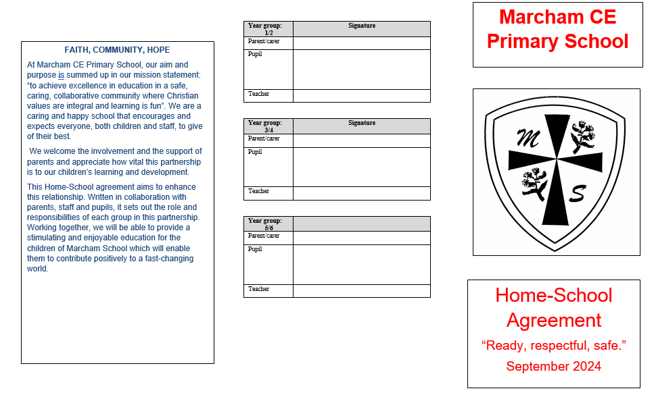
Notes:
It has been slightly amended – but the essence of the document has not changed.

Slide 9
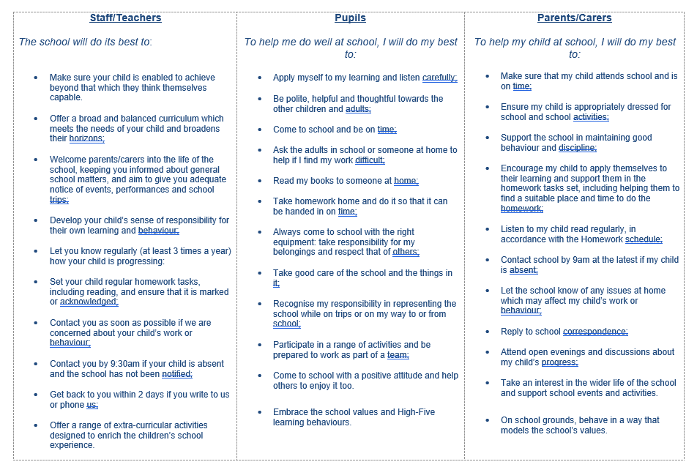
Notes:
Give parents a chance to read it through – have lots of copies available. Explain that the children in KS2 will have the chance to look at this document too. Remind them that none of us are perfect and we don’t always get it right but we aspire to meet these expectation (“I will do my best to…”)

Slide 10
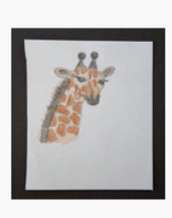
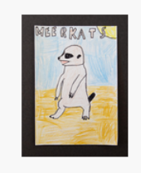

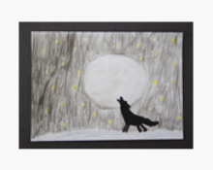

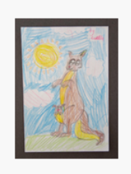
Information about Wolves class
Notes:
These are the pictures from the website. Pick your class picture and make it big and delete the others, or re-arrange and use them all if you want. Personalise the page!

Slide 11

The adults who will work with our class are:
Miss Knowles (all the time)
Ms Jeffries & Mrs Finch
Mrs Callahan & Miss Priddle - Wednesday PM
Mrs Callahan (SENCo) for advice
Notes:
Amend as appropriate

Slide 12
Routines
PE is on Monday and Thursday. The children will need to have both an indoor and outdoor PE kit in school. They should aim to have their kits in school every day.
Reading Books will be allocated through the Rocket Phonics/ Reading Planets platform/ or selected from the class library.
Homework is uploaded on Google Classrooms/handed out on Thursday. The deadline is Thursday. If you have any difficulty accessing Google classrooms please email me.
Children need to be appropriately clothed and bring water, a snack and book bag (with book and reading record) to school every day.
Children do not need to bring anything else to school.
Childrens reading records need to be in daily but will be checked on Thursday for 4 reads.

Slide 13
Curriculum
We want our children to have a broad and balanced curriculum.
Mornings: maths, English, reading, spelling
Afternoons: History, Geography, Art, DT, RE, PE, French, Science, Computing, Music, PSHE
Notes:
Explain that this is not a hard and fast rule but tends to be how the curriculum is plotted during the day. Share your timetable if you’d like and talk a little about what each subject involves.
Share subjects which are taught by other members of staff – e.g. PPA subjects

Slide 14
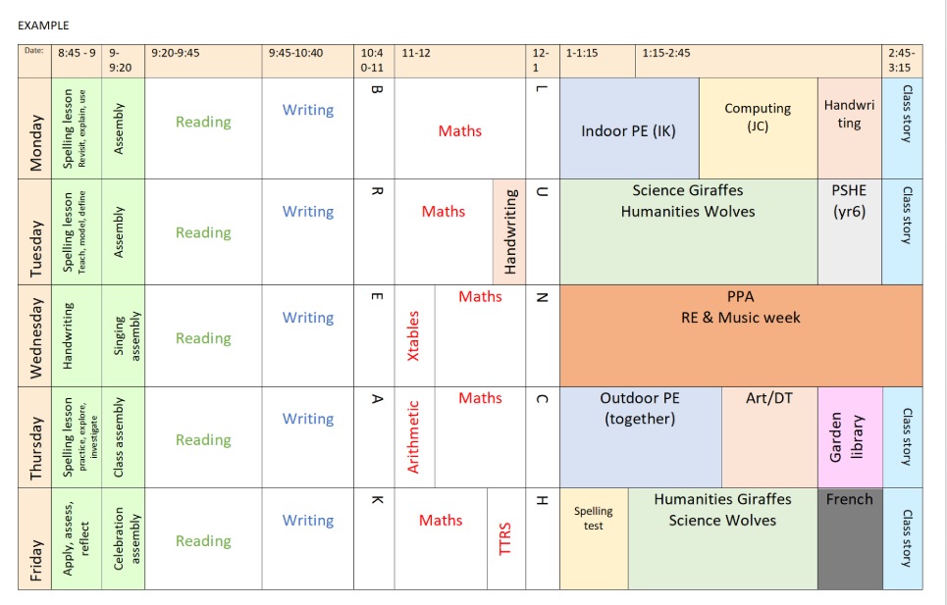
Timetable

Slide 15
How we teach:
Pitch our lessons well and ensure learning happens every lesson, every day.
We ensure consolidation and progression through our planning and medium-term planning structure.
Help children who are finding things difficult (either academically, socially or emotionally) - we want to close gaps and overcome barriers.
Ensure that children are challenged. Learning is hard…
Promote the REACH learning behaviours so that children learn how to be life-long independent learners.
Staff work as a team and share good practice with each other - we use lots of different professionals both in school and out.
Our Learning and Teaching policy is on the school website.

Slide 16

Reading:
Reading is a key skill and fundamental for learning across the curriculum.
1. Listen to them read every day
A small amount of reading practise every day is likely to be more useful than a large block all at once.
Linking the sounds to the letters.
Don’t be afraid to reread.
Practise reading away from reading books. The world is full of text to read – if there are words in the environment that children can read, encourage them to read them as much as possible. There’s nothing like the feeling of using your new reading powers in the real world!
2. Read to them every day
Listening to books and stories that they can’t yet read independently is vital for helping them to enjoy reading, develop their language skills and comprehension, and eventually become a confident reader themselves. We need to drench them in language!
Make a regular time.
Choose a wide range of books.
Don’t be afraid to re-read.

Slide 17
Reading Aims for Year 6 - Things to practise at home
Explain and work out what words mean in context
Justify inferences using evidence from the text
Compare characters and settings within a book
Use quotation for illustration
Identify language the author chose for effect
Explain how presentation of a text supports meaning
Decide if a sentence is fact or opinion
Infer characters feelings from actions, speech, description
Identify and discuss the theme of the book
Compare several texts in terms of style, message and devices
Notes:
Delete as needed – choose your year group!

Slide 18
Reading Aims for Year 5 – Things to practise at home
Explain meanings of new work in context
Justify opinions using evidence from the text
Identify the theme of a book
Identify how authors chose language to consider the reader
Compare how characters change within a book
Summarise the main ideas of a book
Predict what happens from what is stated and implied

Slide 19

Writing
Writing is complex - finding ideas and communicating them in writing is hard. Be positive and find creative ways of practising.
Encourage your children to write at home
​ Ask the children to write down the weekly shopping list.​
Write plays that they can perform in front of you – say for a special family occasion – or just a weekly feature!
Ask the children what they want to watch on TV and get them to make a list, finding out stations, days, starting and ending times. ​
Ask older children to write bedtime stories for younger siblings. The younger children could, the next day, draw pictures of the story and explain what they’ve drawn and why.
Write a letter or postcard and send it to a friend or relative.
Write their own jokes.​
Notes:
There was a parent meeting about how we teach writing last year. The PowerPoint presentation of that meeting is on the website (under Curriculum – English).

Slide 20

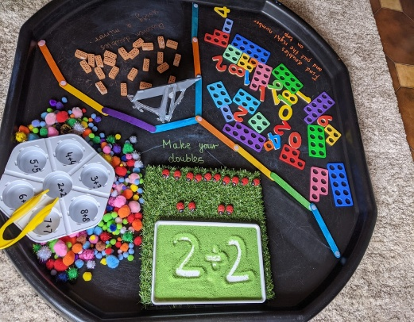

Maths: Calculation Procedures
Information about how we teach Maths can be found on the school website, including PowerPoint presentation given a couple of years ago about how you can help to embed Maths learning at home
If you are unclear how your child has been taught, because it is different to how you were, then this will be your first port of call. Of course, we want to help you so you can help your child! Please make an appointment with me if you need further help or advice.

Slide 21



How you can help your child - Maths
Topmarks – Daily 10: fluency activities to support number skills.
I see maths is an organisation recognised by NCETM (National Centre for Excellence in the teaching of Mathematics). They have suggested some games parents can play with their child to encourage strategical reasoning and thinking.
Games and Resources - I See Maths
Practise your times tables on Times Table Rock Stars- 10 minutes a day would be ideal- teachers can still see it

Slide 22
Homework in Year 5/6
Homework is set on Thursdays and is due to be returned to school on Thursdays.
Each week there will be an English and Maths activity to consolidate learning within the classroom.
Reading logs are checked every Thursday and if there are less than 4 reads, the child will stay in with me at breaktime to catch up with some reading.
Notes:
Amend as necessary…

Slide 23
Special Educational Needs
SEN covers social, emotional and mental health needs, communication and interaction needs, cognition and learning needs, physical and/or sensory needs, fine motor needs, specific learning difficulties such as working memory needs or processing needs.
If you think your child might have SEN, or if we think your child might have SEN, we will be in touch or in the first instance please contact your class teacher
If your child has SEN, there are 3 additional meetings a year- November, February and June. These are with the class teacher and Mrs Callahan may join where appropriate to do so.
The SENCo ( Mrs Callahan) has strategic overview of the provision for all children with SEN in the school
As a school, we know the biggest impact on pupils with SEN is:
Quality First Teaching
Targeted interventions- time focused and practicable targets.
Adults asking your child their opinion and adjusting practise as needed
Governors monitoring our SEN support

Slide 24
Reminder: Ways you can help your child…
Please be on time in the morning. Gates open at 8:35am
Eat well- bring a fruit snack
Send them with a water bottle – with just water in (Feeling thirsty can affect learning and memory function by 10%)
Read every day – try to make it part of your routine. Be a role model for reading.
Support them to complete homework activities
Help your child become independent- make sure they
bring the correct things to school, carry their own bags etc

Slide 25
How you can help your child- sleep
We all know that sleep helps us to:
Learn better- our brain forms new pathways in our sleep
Improve our emotional and mental wellbeing
Communicate and interact well with others
Helps us grow, repair cells etc
Please help us by having a set bedtime, set routine, reducing screen time before bed and down time.
Notes:
Remind them of the Home-School Agreement and encourage them to take one home if they’d like to. We have Three rules – found on the front of the agreement; Ready, Respectful, Safe. Helping your children to be Ready to learn will make such a difference to their outcomes.

Slide 26
Diary Dates – check the newsletter for updates.
Week of 21st September – Music Flood week
Thursday 1st October – School Photographs
Thursday 8th October – Harvest Festival – 2pm
Thursday 15th October – Open morning (8.35 – 9.05am) – come and see you child in their classrooms, look at their books and find out about their learning.
Friday 23rd October – INSET day – school closed for children
Monday 2nd November – Term 2 begins
Notes:
A reminder of things coming up. You will already have spoken about any trips on Slide 13

Slide 27
How to contact Miss Knowles
You can email me: i.Knowles@marcham.oxon.sch.uk
Message me on ClassDojo
Or email me through the office if it is about attendance.

Slide 28

Any questions?
Notes:
If there are lots of questions, or they become personal, you might want to encourage parents/carers to wait behind so that you can discuss it more appropriately with them – and it means other parents can go home!

Slide 29
Thank you for coming!

